Slide 1



Wills and EPOAs
Understating their importance
November 2025

Slide 2


Fiona Faithfull
Partner, Albany
Olivia Lucas
Solicitor, Albany

Slide 3
Our story in numbers
+105...
years
strong
3
offices
135
people
20
partners
39
practice areas

Slide 4

McVeagh Fleming in the Community
Dementia New Zealand
Will and EPOAs at cost rate for those with a diagnosis of Young Onset Dementia and 10% discount for all with a dementia diagnosis
Working with More than Money and Westpac presenting webinars
Targeted Scheme
Working with Dementia New Zealand to identify those in need and offering a service where EPOAs (and wills) are prepared free of charge.

Slide 5
Contents
01
02
03
Wills
EPOAs
Questions
Feel free to stop us and ask questions as we go
What is included in a will?
Joint Tenants v Tenant in Common
Challenges to Wills
Dying Intestate
FAQs
What are EPOAs
Losing Capacity without EPOAs
FAQs
© McVeagh Fleming. Commercial In Confidence.

Slide 6


Slide 7
What is included in a Will?
Other Considerations
Executor
Specific Gifts
Transfer of powers relating to control of trust
Forgiveness of debt
Guardianship
Provisions for blended families
Domicile and overseas assets
Marriage
Potential Challenges to the Estate
(see later slide)
Current ownership structure
(see later slide)
Revocation of prior wills
Digital Legacy
Funeral instructions
Organ donation
Burial/cremation
Gifting of Residuary Estate

Slide 8
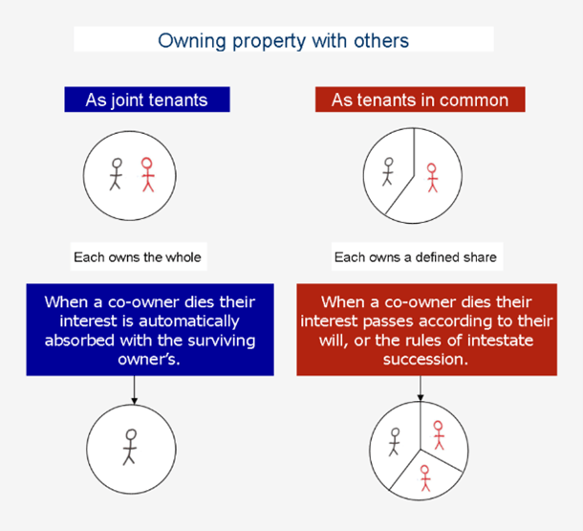
Current Ownership Structure
Joint Tenants
Each party owns the whole of the property jointly with no divided shares.
Tenants in common
Each party owns a defined share in the property.
When a co-owner dies the property will pass according to the deceased will, or the rules on intestacy.
Right of survivorship applies and the property will not be subject to the deceased will.

Slide 9
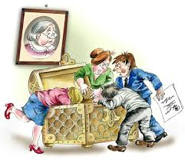



Challenges to Estates
Relationship Property
A surviving Spouse or de facto partner of the deceased has 6 months from the grant of probate to elect to either accept their entitlement under a will or make a relationship property claim against the estate.
Testamentary promises
A person can lay a claim against an estate where the deceased made a promise to provide for that person and that person completed work in reliance of this promise.
Family Protection Act
The FPA imposes a “moral obligation” for parents to provide for their children. Excluding a child from receiving under a will opens an estate to a challenge
There are other challenges such as the will maker lacking mental
capacity, undue influence,
improper signing or witnessing,
existence of a mutual will.

Slide 10




Dying Intestate
No Control
Extra Administration
This includes requirements for advertising to find any unknown will and relatives
Delays
Extra Cost
Without challenges from third parties, obtaining Letters of Administration usually cost approximately twice as much as obtaining probate
Distribution is determined by s77 of the Administration Act
Generally…..
Partner and children
parents
siblings
With a surviving de facto partner or spouse and children, the partner/spouse will receive the
personal chattels, the first $155K and thereafter
the partner/spouse receives one third and
issue(s) receive(s) two thirds

Slide 11
Frequently Asked Questions
How do you prevent a Challenge to an Estate?
Contraction out Agreements – note owning property through a trust does not necessarily mean that it will not be open to a relationship property claim.
Inter vivos gifting
How can you minimise time and costs of Estate Administration?
Probate is not required for Estates with less than $40k effective from 24 September 2025. this was previously $15K
Holding major assets in a family trust or through joint tenancies excludes them from the calculation above
Do you need a lawyer to make a will?
No, unlike EPOAs to be discussed next, Wills do not need to be drafted or witnessed by a lawyer
Ownership of property through a trust
Property held in trust requires very little legal administration (usually updating trustees on titles/ownership documents) and there is no time delay
Joint tenancies (This is not always an appropriate structure)
These structures are not always appropriate Joint tenancies are not appropriate for vulnerable people or people who have bended families and what to benefit their children.
There are strict signing requirements which, if not met, will necessitate court action to validate the will.
Getting a will wrong will cost a lot more in the long run than paying a lawyer to draft and witness your will. Wills are complex and touch numerous areas of the law so it is best to ensure they are correct to allow a smooth pathway for your loved ones.

Slide 12
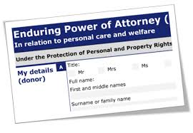

Slide 13

Enduring Powers of Attorney are essential legal documents that are often overlooked and undervalued
They allow people to deal with your affairs in the event that you are unable to
Act now! By the time you need them, it is too late to put
them in place.

Slide 14

Enduring Powers of Attorney (EPOAs)
Property
Both real property and personal property
Personal Care & Welfare s
Level of care and place of care
Joint nomination
Mentally capable and mentally incapable
Advance Directive to assist with decisions
The tough decisions
Individual attorney nomination

Slide 15

The only alternative…
Time
Delays
Extra
costs
Uncertainty
If a person loses capacity without an EPOA in place a Court order under the Protection of Personal and Property Rights Act (PPPR) is required to deal with their affairs
Expiry

Slide 16

FAQs
What is the usual process for activating EPOAs?
Are there any restrictions for who is appointed as an attorney/successor attorneys?
At what point does an EPOA become binding?
Can an EPOA sign as directors/trustees/shareholders?
Can an attorney be named that does not reside in New Zealand?
At what point does an EPOA come to an end?
What are some of the key obligations that an attorney is bound to abide by?
Can an attorney decide on assisted dying?

Slide 17




Affordable Options for Wills & EPOAs – What You Need to Know
 | Public Trust Pricing | WHY WE DON’T RECOMMEND PUBLIC TRUST One-size-fits-all approach No tailored advice for your family situation Higher risk of invalid documents
 | Basic Will – $69 Very limited: No guardians for children No blended family provisions No trusts Estate must be divided equally
 | Comprehensive Will – $750 (Reciprocal) Covers most basics, but: No bespoke advice No witnessing support → Risk of invalid Will | EMERGE AOTEAROA OFFER Reciprocal Wills – $500 EPOAs (Property + Personal Care & Welfare) – $1,000 (Includes both EPOAs and Wills, provided no conflict with successor attorneys)
 | Enduring Power of Attorney (EPOA) – $1,410 Includes property & personal care/welfare EPOAs

Slide 18
Questions & Answers

