Slide 1

RENTING Vs
Pathway to Homeownership
Notes:
---

Slide 2
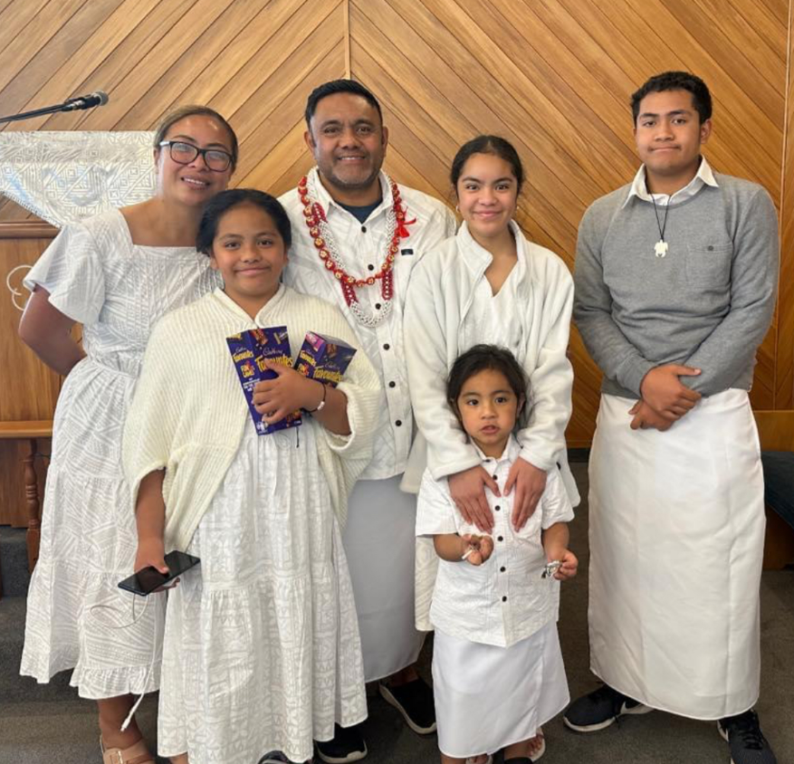
Welcome & Intro
Facilitator Introduction
Talofa & Kia ora e te whanau. My name is Theresa Alaimoana. I am a NZ born Samoan living in Hamilton – born and raised Auckland.
Workshop Purpose
  The goal is to empower participants to transition from renting to owning a home with clarity and motivation.
Questions
Drop in the group chat box and I will answer at the end.
Notes:
Talofa lava and Kia ora e te whānau. Thank you for joining us today. Welcome to our workshop: Pathway to Homeownership. My name is Theresa Alaimoana. I’m a New Zealand-born Samoan, raised in South Auckland, and have been raising our 4 kids with my husband in Kirikiriroa, Hamilton since 2018. My parents hail from the villages of Falelatai and Laulii . I’m a financial capability facilitator and coach. Prior to this I was a mortgage broker for 6 years in Australia and New Zealand, and have been in the accounting & finance industry for 20+ years Not only do I work closely with families in a professional setting, but I also bring compassion into my work having lived experience of being raised with very little to buying my first home at a young age.
I’ll share more about my personal story later on.
Today’s session is a high-level overview of the steps to homeownership. It forms part of a series designed to help you learn, apply, and reinforce knowledge.
My goal today is really to empower you with clarity, motivation, and practical steps to move from renting to owning a home. I hope I achieve this goal today for you. For the sake of time, I will run through the workshop as is, if you have any questions drop it into the chat and Ill try to answer them at the end.

Slide 3

Why Homeownership?
Renting vs Homeownership
  Pros: Renting offers shelter over a set period time.
  : Offers flexibility
  Con: It builds wealth for landlords, not tenants.
  : Landlords have control over how their property can be used, and can have a choice of who their tenants are, also when tenants move out
Building Long-Term Equity
  Homeownership creates equity, financial security, and wealth accumulation through property appreciation.
Stability and Legacy
  Owning a home provides stability, pride, and a legacy for future generations.
  Generational Wealth & Financial Independence
  Homeownership builds generational wealth for your children, your mokos, and creates opportunities and financial independence for you and your family
Notes:
Renting vs Homeownership – Why Homeownership?
There are pros and cons, and if I am honest I can personally think of more cons than there are pros.
Pros: Renting offers shelter over a set period time. It does offer flexibility if you want to live in a particular area that is expensive but unable to buy a home in that area.
Con: : Landlords have control over how their property can be used, and can have a choice of who their tenants are, also when tenants are to move out
: Tenants are subject to rent increases every year, inspections every few months and it can be unsettling when landlords decide to sell or move back in.
The key point that’s often overlooked by tenants is that: renting builds wealth for landlords, not tenants. For landlords, rental properties are a business. For tenants, we make it our home—a place where we settle, raise our families, and get comfortable. But we often forget that one day, the landlord can make decisions that change everything. It is great to have – a solution for shelter and security, but it doesn’t offer long-term stability or a tangible asset that we can call “ours”
Building Long-Term Equity
Homeownership creates equity, financial security, and wealth accumulation through property appreciation.
Stability and Legacy
Owning a home provides stability, pride, and a legacy for future generations.
Generational Wealth & Financial Independence
Homeownership builds generational wealth for your children, your mokos, mokos mokos and creates opportunities and financial independence for you and your family
opportunities such as education : where you have a choice with what schools you can send you kids too, leverage your home to start or invest in businesses. Even build and buy more property – maybe building that small whare behind your home for your elderly parents. Keeping whanau together, and leaving a tangible/physical asset behind for your kids. Peace of mind that they have a home that they own. Owing your own home provides choice and opportunity and has the potential to build a legacy for generations to come.
Empowers financial independence – you are in control of your asset. Not only can you put your taro plantation you’ve always dreamed of doing. If you know you know. You become the land lord or land lady. This is empowering to know that you are in the drivers seat.

Slide 4
Personal STORY
Notes:
My Story

Slide 5
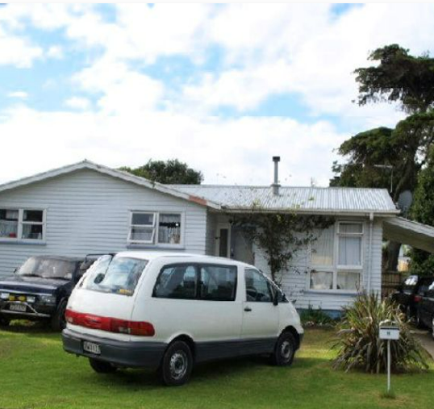
MY Story
Early Life Challenges
  Grew up facing poverty, debt, and limited financial literacy in a Housing NZ home, shaping resilience.
Taking Responsibility Early
  As eldest of four, balanced school and multiple jobs, demonstrating early responsibility and dedication.
Achieving Homeownership
  Saved $10,000 by age 19, enabling family to buy their first home, showing power of mindset and action.
Notes:
My personal journey to homeownership that im sharing today is one to inspire and empower anyone who feels that homeownership is out of reach and that owning a home is achievable – whatever your social status. Like myself- I had started from humble beginnings . My siblings and I grew up in social housing. This is the home we knew for the first 19 years of life. We experienced first hand the challenges that come with poverty as a result of high interest loans, alcohol, gambling addictions, helping family overseas and parents who only knew what they knew – but the emotional, mental and physical challenges that come with vulnerable situations created an environment where it was impossible to see anything past it. Being the eldest of four, I took responsibility at a young age, working multiple jobs while in school and saving most of my pay each week for 3 years. By age 19, I had saved $10,000, enabling my family to buy their first home.

Slide 6
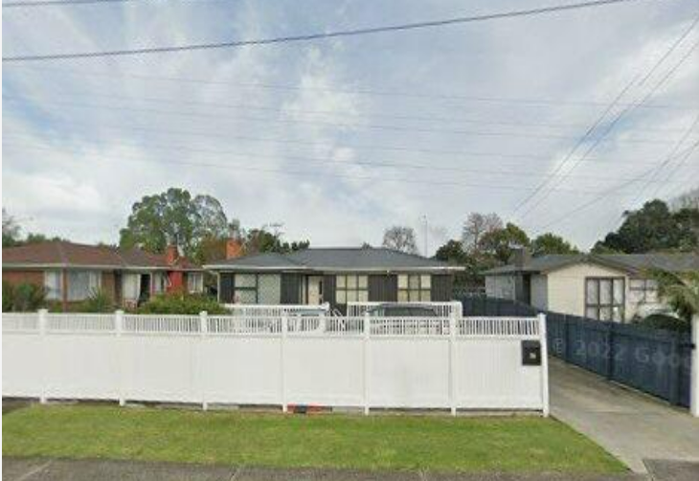
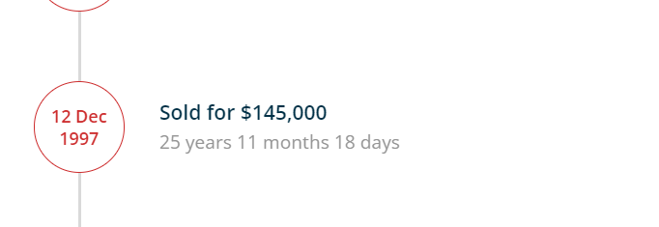
Dec 1997 – First time - Home Owners
Purchase: $145,000 in 1997
Sold: $305,000 in 2005
Notes:
This was our first home at the age of 19 - a home we called our own.

Slide 7
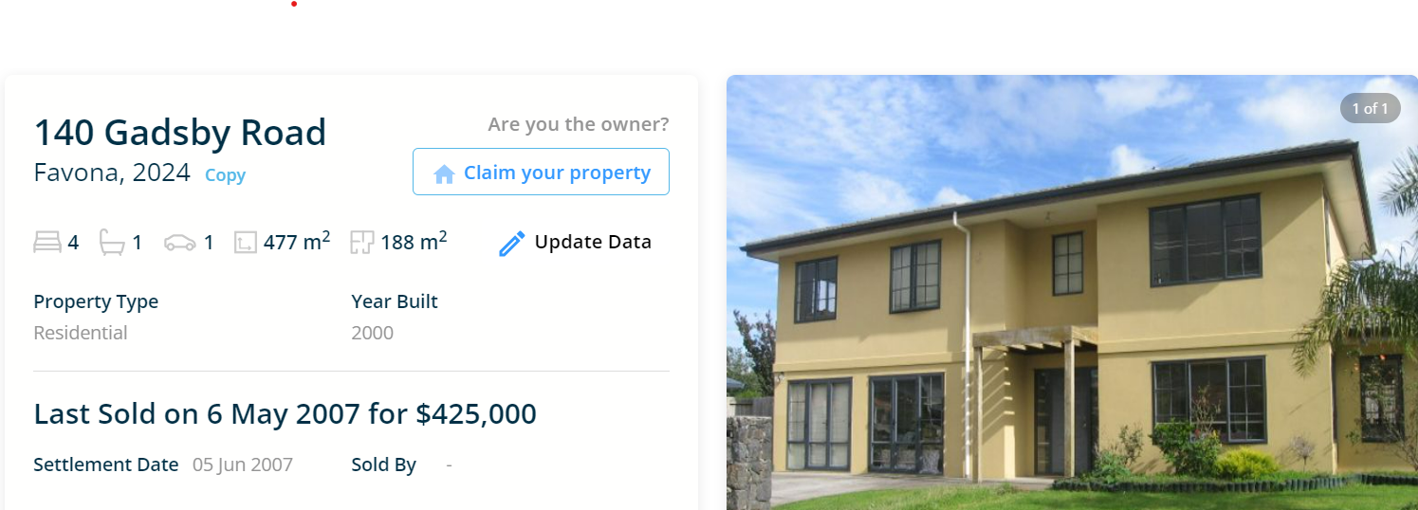
2nd Family house – Bought in 2006 for $375,000
Notes:
10 years later we sold our 1st home as our family grew from kids to adults, we upgraded to a bigger house in early 2000’s before I moved to Australia where I married, continuing the pathway of being a homeowner – buying, selling, leveraging from one property to buy or build the next – to becoming an investor myself. What is interesting here that although we moved to Australia – different country with completely different housing rules – the fundamentals of financial literacy – such as budgeting, saving and managing money well- remained the same. It was here that I realised that it didn’t matter about how much you earned, but how well you managed what you earned. Living within your means.

Slide 8
Mindset and Motivation
Notes:
Mindset Shift: Your vibe attracts your tribe

Slide 9
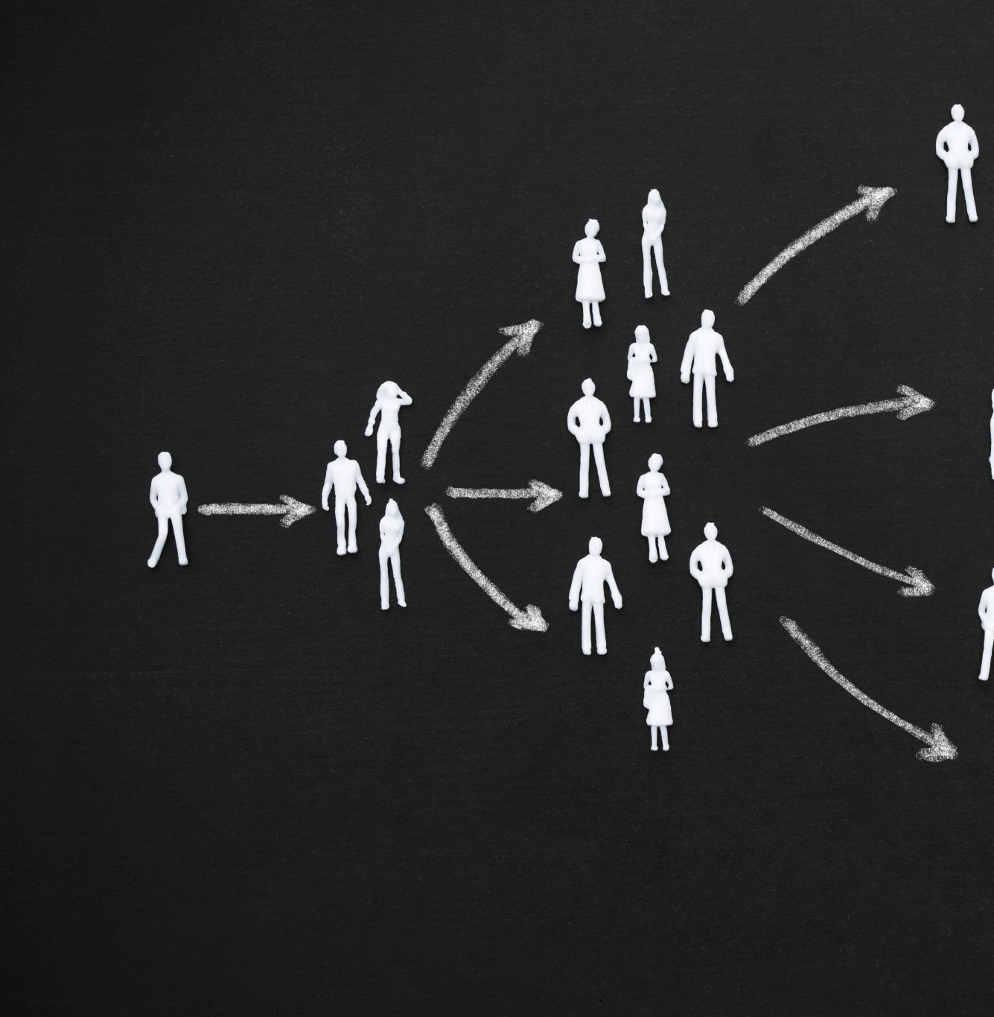
Mindset Shift: FROm Scarcity to Growth
Mindset and Homeownership
  Belief and intentional action are essential foundations for achieving homeownership success.
Attracting Opportunities
  Positive thinking and proactive behavior attract financial and personal opportunities.
Visualization and Support
  Visualizing goals and surrounding oneself with supportive people fosters disciplined habits.
Abundance Mindset Shift
  Shifting from scarcity to abundance mindset breaks poverty cycles and builds generational wealth.
Notes:
How did this 16- year old even know about homeownership? On paper, my environment should have projected a different path but Gods plan and he was always in full control. For me when I reflect it began with the right mindset - shifting from a scarcity mindset to an abundance one, and secondly it was creating consistent habits & being disciplined about it. Habits that served me well as an adult, and passed onto my kids (I hope they have been listening and watching) It really was visualising the goal, making a plan, adopting disciplined habits towards achieving that goal, One key advice that has also helped elevate my thinking and influenced some of my decisions is surrounding myself with the right and successful people who genuinely want to see me succeed as well. Those who walk the talk. Your vibe attracts your tribe. Eg: Would you take financial or budgeting advice from someone who has never owned a home, or from someone who is always in debt?

Slide 10

Practical Steps
Budgeting
  Track income and expenses carefully to identify opportunities to save towards homeownership goals.
Reducing Debt & Improving Credit Score
  Pay bills on time, reduce debt, and avoid payday loans to enhance credit scores effectively.
Consistent Savings Strategies
  Start saving small amounts consistently using tools like KiwiSaver and family support for steady progress.
Notes:
The essential steps toward homeownership is getting in the know and really understanding how money can work for you. What does this look like? 1) Budgeting: Track income and expenses to identify savings opportunities. 2) Credit report and score: Maintaining a score more than 500 by paying bills on time, reduce debt, and avoid short term loans such as credit cards, after pay..Things that take away from your goal 3) Savings Strategies: Start small and build consistently, using tools like KiwiSaver and family support..

Slide 11

What Banks Look For – 4 C’s
Income Stability - Capability
  Banks evaluate consistent income to ensure borrowers can meet mortgage repayments reliably over time.
  Deposit – Capital
  The money you have available for a deposit and other upfront costs
  A strong savings record demonstrates financial responsibility and ability to handle future expenses.
Credit Score and Debts – Character
  Good credit scores and manageable existing debts assure banks of borrower’s creditworthiness.
Family Situation - Capacity
  Banks consider family responsibilities impacting financial stability and repayment capability. Eg: How many children you have, whether you tithe etc
Notes:
the key factors banks consider when approving a home loan: income stability, deposit and savings, ability to pay your rent on time, credit score, existing debts, and family situation. Banks consider family & cultural responsibilities impacting financial stability and repayment capability. Eg: How many children you have, whether you tithe, whether you regularly send money home. This is all taken into account, and is acceptable because it is important to us.
The key thing they are looking for is that you can demonstrate financial responsibility through paying obligations including debt on time. Have a good steady income. Banks want reassurance that borrowers can manage mortgage repayments now and over the 30 year term.

Slide 12

Getting Your Deposit Together
Combining Saving Sources
  Build your deposit by combining personal savings, KiwiSaver contributions, and family gifting effectively.
Benefits of Higher Deposit
  A higher deposit lowers borrowing costs and interest payments over the loan term.
Start Small and Consistent
  Begin saving with small amounts consistently to steadily reach your homeownership goal.
Notes:
Building a deposit:. The general deposit required is 20% however banks are accepting as little as 5% which may cost a little bit more but it gets you on the property ladder. There are 3 ways to build a deposit ; personal savings, KiwiSaver contributions, and family gifting
Personal savings – encouraging to start small and remain consistent - every dollar saved brings you closer to homeownership. How to find that extra cash to save – is first of all understanding where your money is going and understanding the difference between what is essential and what isn’t. Do I buy a $9K car to get me to A to B or a $40K car because it looks good and my cousin has one. Also what I have found is how people structure their bank accounts. Where they mix personal and business all in one, or there are 3-4 different accounts with no real purpose for each one.
2) Kiwisaver – a government scheme and is also most common form of a deposit. Not only are you contributing to your kiwisaver whether it is 3% or 10%, the employer is also contributing to your kiwisaver too. It is the best type of savings because it is the only one you can’t easily withdraw from unless you are buying a home or financial hardship.
Knowing the ins and outs of your money, and being in control of it rather money control you is the foundation for financial readiness and demonstrates to lenders that you are responsible and capable of managing a mortgage. There are many FREE coaches like myself across Aotearoa who can help you to learn essential skills to get you bank-ready

Slide 13

Managing Debt & Understanding Credit Score
Prioritise High-Interest Debt
  Focus on paying off high-interest debts first to reduce overall financial burden efficiently.
Avoid Payday Loans
  Steer clear of payday loans due to high fees and interest that can worsen debt situations.
Monitor Credit Reports
  Regularly check credit reports to identify and correct errors, ensuring accurate credit information.
Maintain Low Credit Utilisation
  Keep credit utilisation low to improve credit score and demonstrate financial responsibility.
Notes:
Im going to touch on the most common traps that a lot of our hardworking families get caught up in. It is debt. It is not understanding the true cost of debt, not getting the right advice before signing a contract and its impacts on your credit score. A strong credit score signals reliability to lenders and increases the likelihood of a home loan approval. Definitely looking after your credit score,minimizing the use of credit such as credit cards , buy now pay later schemes & keeping the score above 500 and checking it regularly (at least once a year) is important to pick up any errors early. Particularly if you’re anything like my family where dad, son and cousin, nephew all have the same names.

Slide 14
Exploring Options
Notes:
Homeownership Pathways,

Slide 15

Homeownership Pathways
Traditional Pathway
  Save for a deposit and apply for a mortgage through a bank or lender to buy a home.
Rent-to-Own
  Pay rent that partly contributes toward eventual homeownership over time.
Shared Equity
  Partner with a housing provider or government to help increase a deposit and reduce upfront home purchase costs.
Notes:
Some of you may be thinking oh geez this is going to be impossible for us – I have terrible credit, I have too much debt, Im on the benefit. I will encourage you to get a coach to work through the options. Because there is more than one way to achieve homeownership. The three main pathways: 1) Traditional Pathway: Save for a deposit and apply for a mortgage through a bank or lender. 2) Rent-to-Own: Pay rent that contributes toward ownership over time. Generally after 5 years – you have the opportunity to buy the home that you are living in 3) Shared Equity: Partner with a housing provider or government to reduce upfront costs. Particularly deposits. These options make homeownership accessible to families with different financial situations. How this looks – the family come up with 5% deposit, and the provider makes up the rest up to 25 to 30%. Obviously it is important to exercise due diligence and you are working with legitimate organisations, and get the right advice for these products but there is definitely is more than 1 way to achieve homeownership.

Slide 16
NEXT STEPS
Notes:
Visualise, Plan and Action

Slide 17

Visualise, Plan and Action
Visualize Your Dream Home
  Encourage participants to clearly imagine their ideal home to set a motivating goal.
Create a Realistic Plan
  Stress the importance of developing step-by-step plans to turn dreams into achievable goals.
Take Intentional Action
  Motivate participants to begin taking concrete actions without delay to realize homeownership.
Support and Mindset
  Highlight the role of a positive mindset and support network in sustaining the journey to homeownership.
Notes:
As we wrap up - I encourage you as I have done for myself and my family and have coached many others to do the same over the past 3 years is to- visualise the home, right down to its specifics from the size, location, how many rooms etc – draw up on a vision board, write it in a journal- create a plan, and take intentional steps toward achieving it. homeownership is possible with the right mindset, a tailored plan and then actioning the plan with the support of your tribe. The tribe is: a financial coach, a mortgage broker and a property lawyer.
As mentioned, this workshop is part of series of in depth workshops designed to guide you through every stage of the journey.. If you have any questions or you wish to know more about how to register for the next workshop – please get in touch with the generator team. I hope you’ve all enjoyed todays workshop and have taken away a few golden nuggets to help you think about where you are and where you would like to be. So I definitely encourage you to find a financial coach and mentor to help you. As the saying goes – if you want to go fast, go alone, but if you want to go far – go with others.
Thank you again for the opportunity

